Slide 1
Instructions: How to Run The Image Acquisition System
Samir Hossain
Updated: 06/08/2025

Slide 2
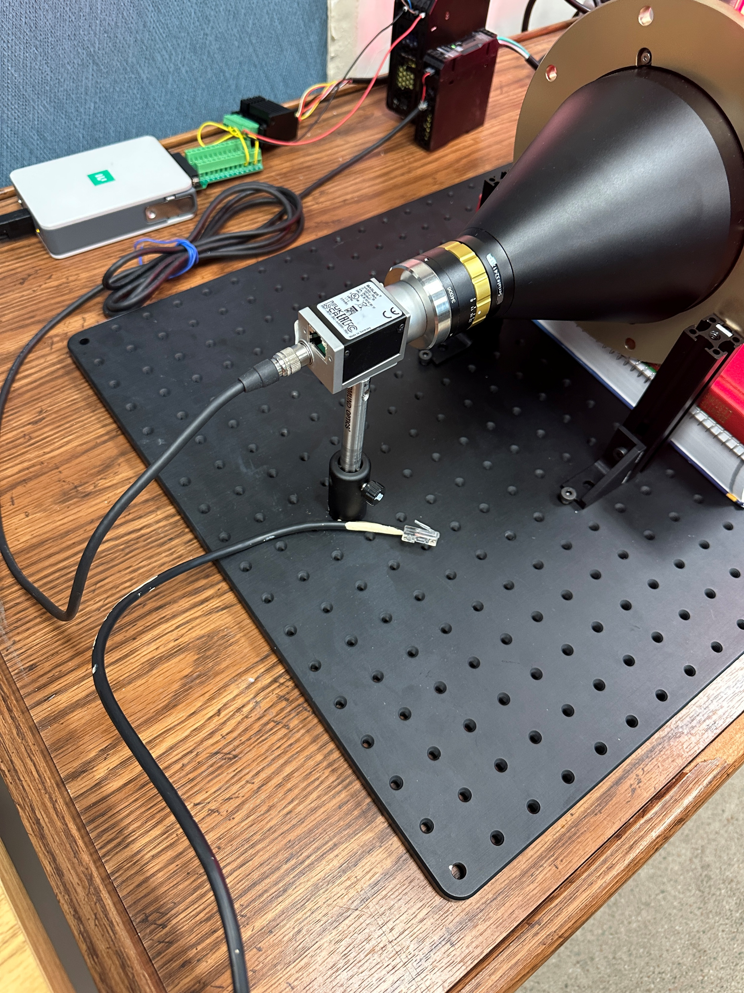
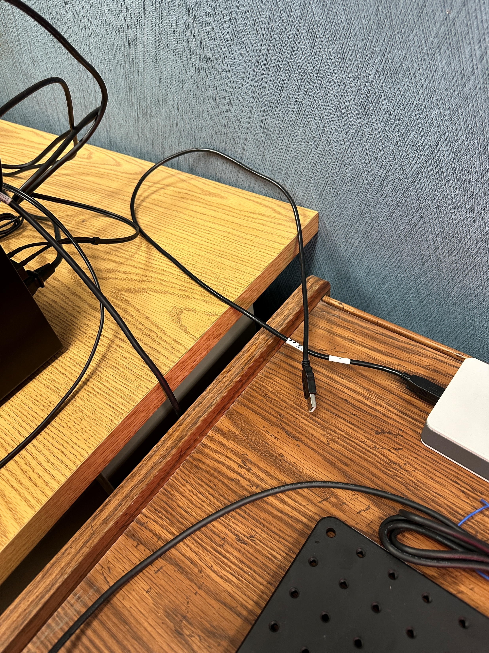
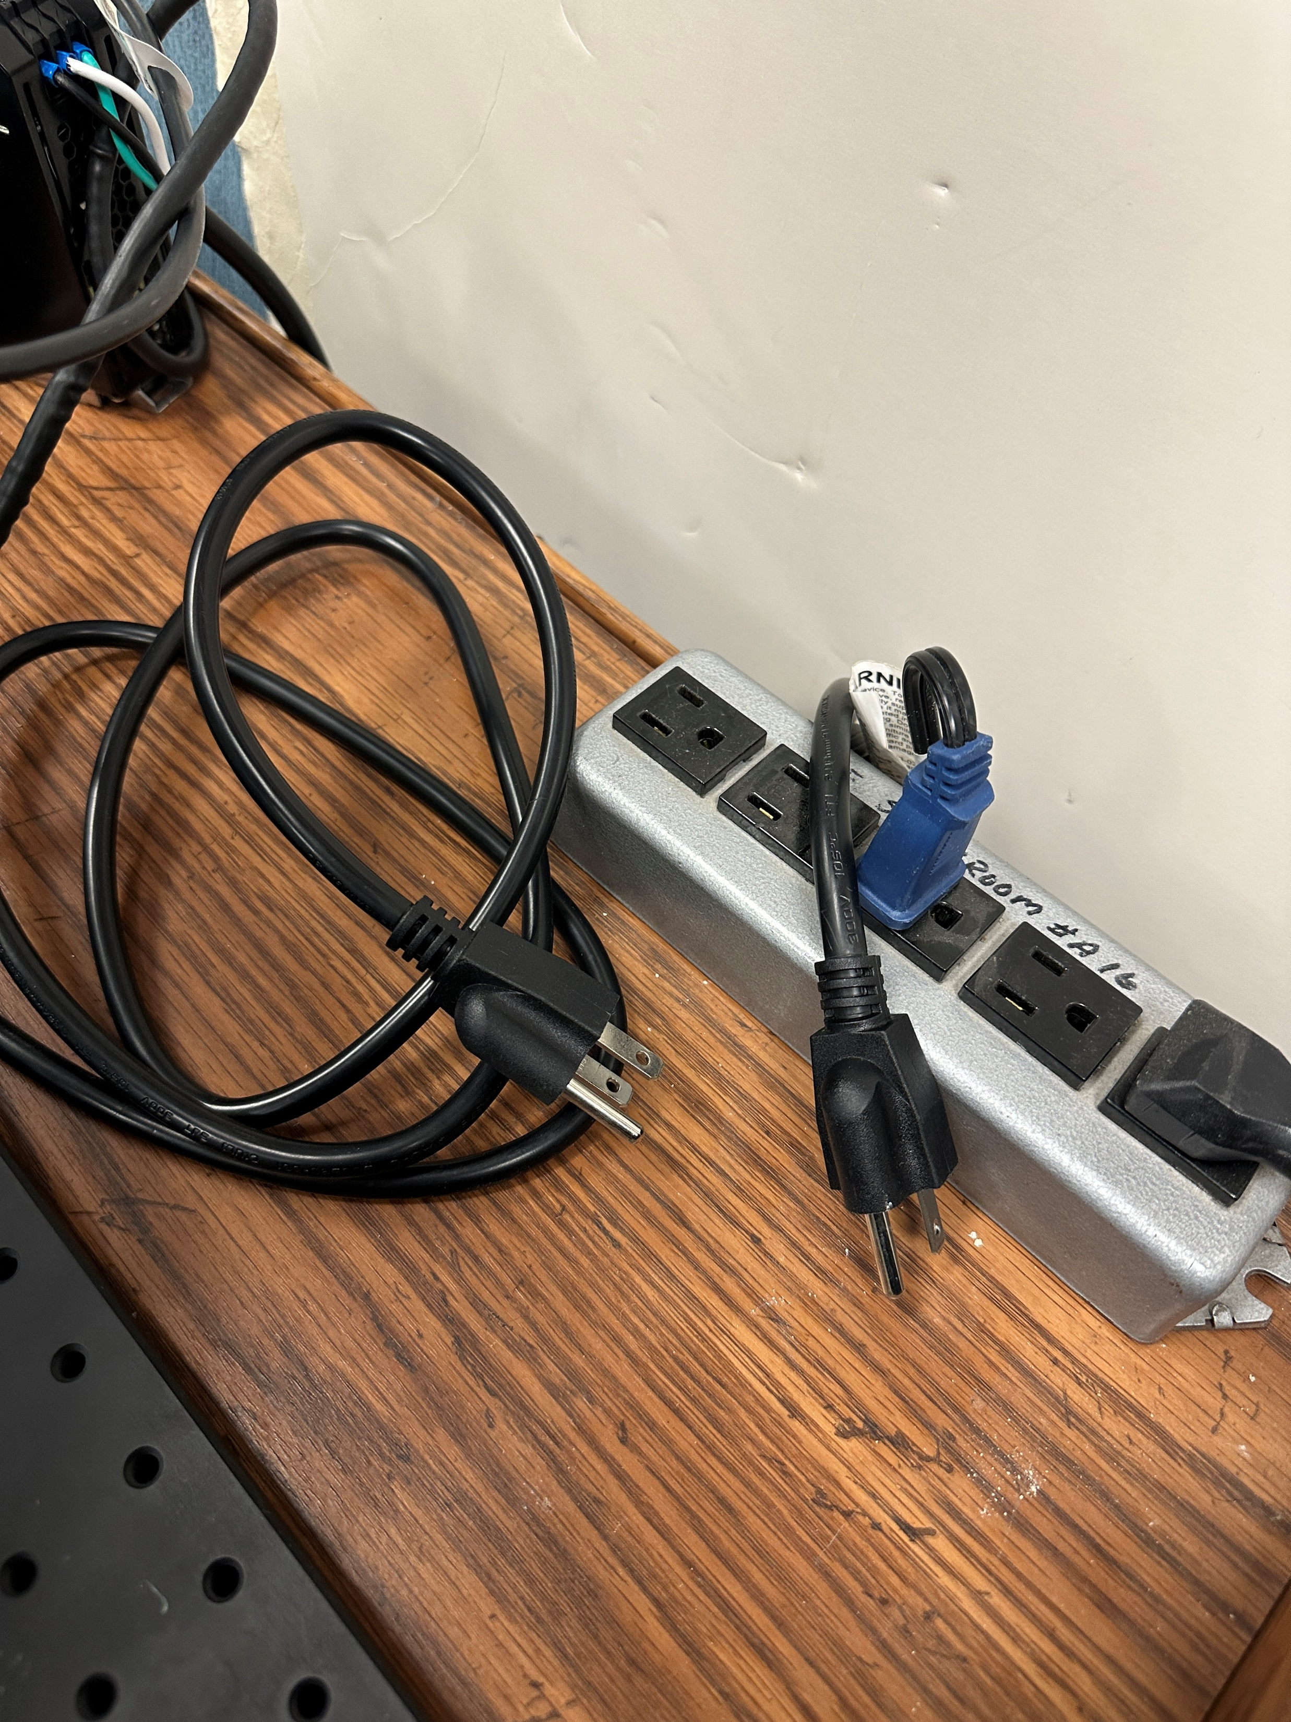













Step 2: Connect Power and Data Connections
Step 1: Start the Computer and Enter Pin 9635
Disconnect all of these when leaving

Slide 3
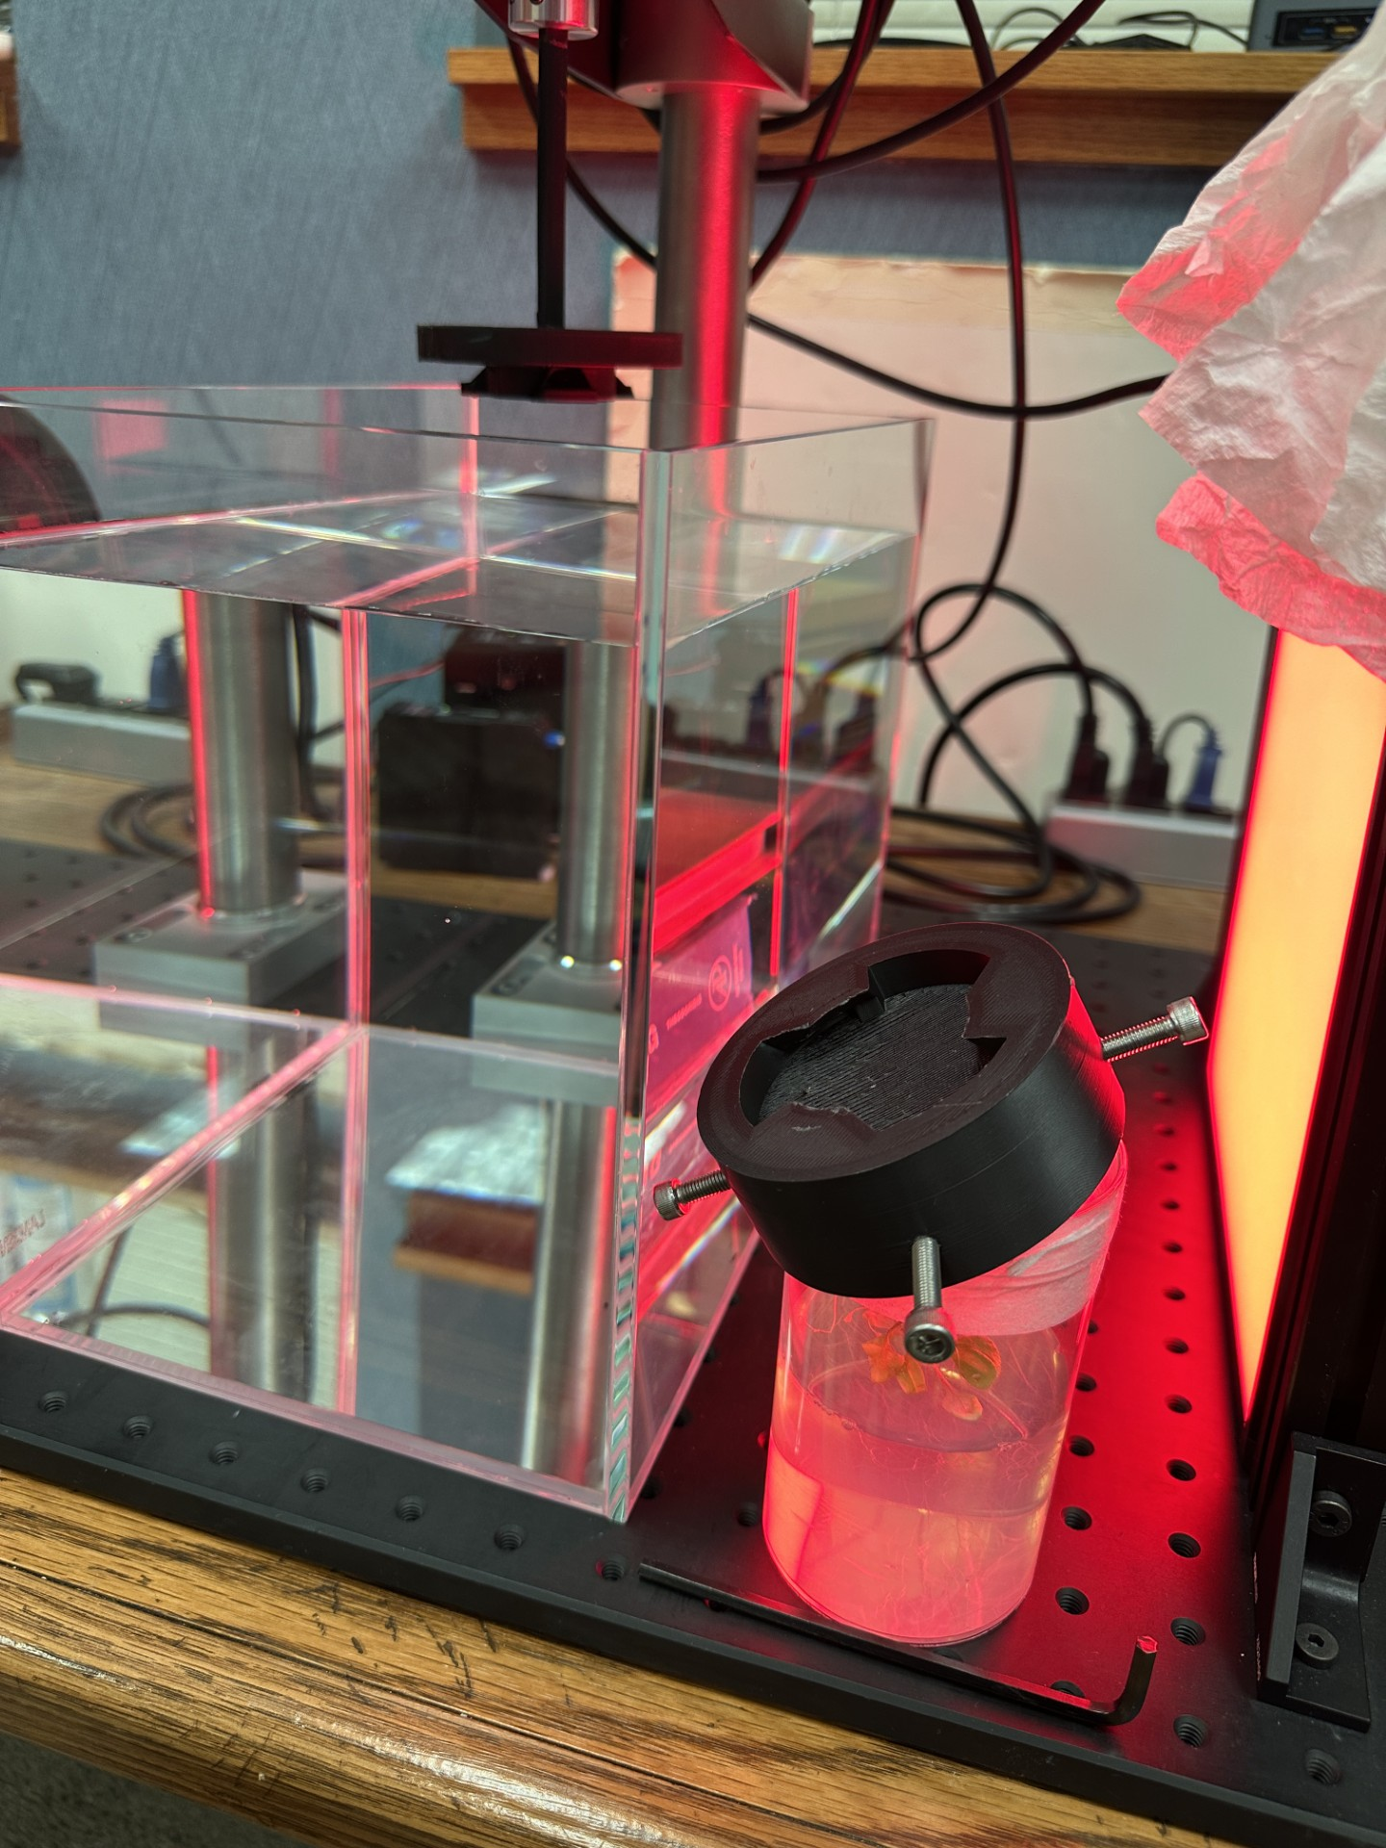










Step 3: Attach the Sample to the Motor Attachment

Slide 4
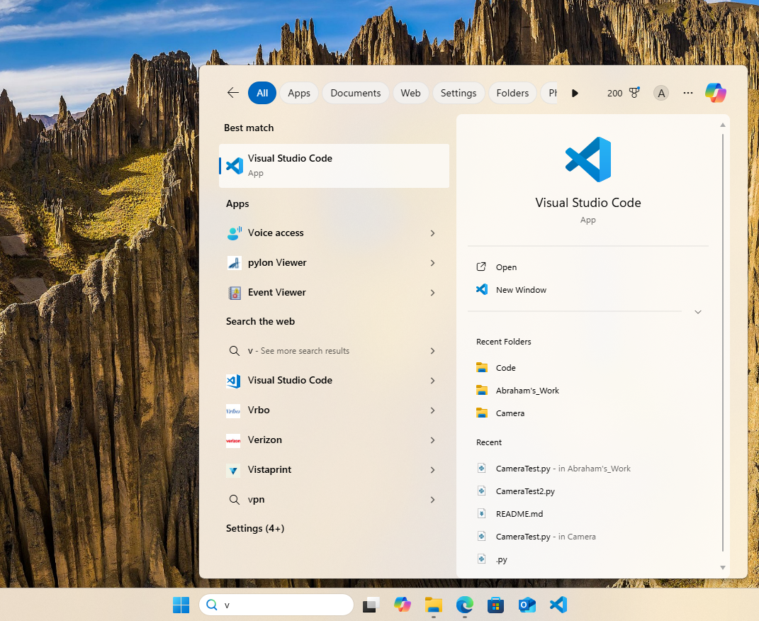
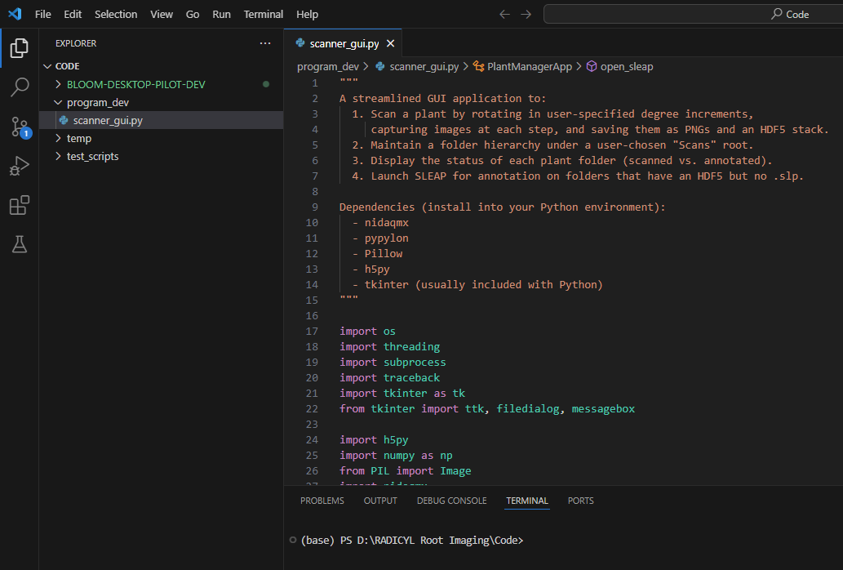



Step 4: Start VSCode and get to scanner_gui.py
All scripts are in D drive -> RADICYL Root Imaging -> CODE We are interested in the scanner_gui.py in the program_dev folder

Slide 5
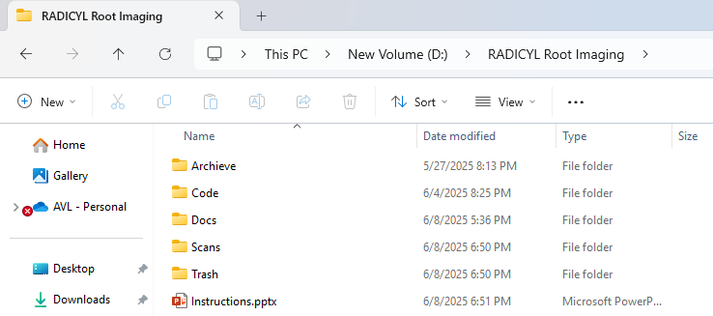
File system for this project
Archive: Contains previous work done on this project Code: All code related to this project
Docs: All documentation/datasheets Scans: All results saved over here Trash: Ignore; Contains "stuff" that might be needed later

Slide 6
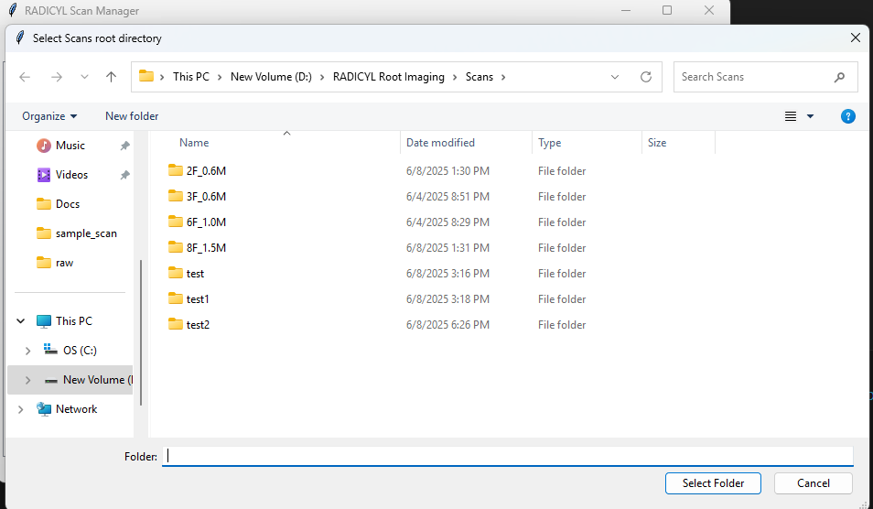
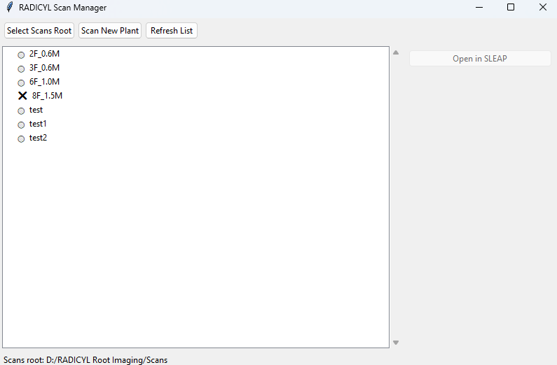
Step 5: Start the scanner_gui.py script
Choose the Scans folder where we will save all samples
The program goes through the Scans folder and finds samples, "✅" # annotated ; "O" # scanned only; "X" # not yet scanned

Slide 7
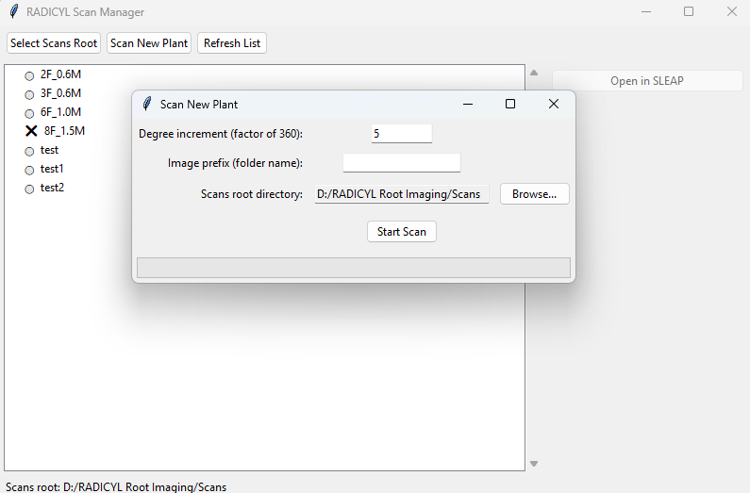

Step 6: Scan New Plant
Clicking "Scan New Plant" gets you the option to choose degree increments default to 5 degrees following the paper.
Image Prefix is basically the sample name. If you are just testing then put anything (e.g. test x) Make sure not to repeat a name as that will overwrite the folder. Start Scan starts the scanning

Slide 8
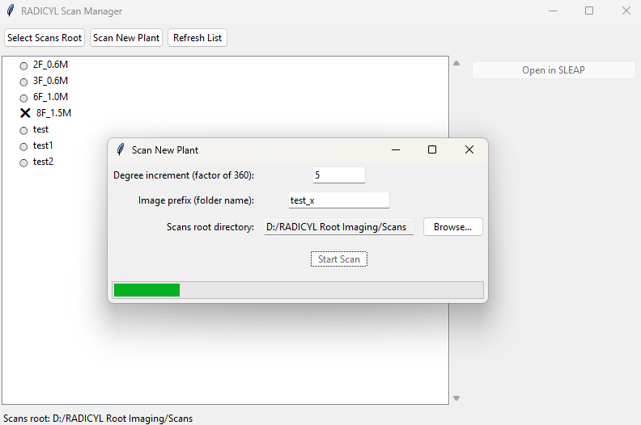
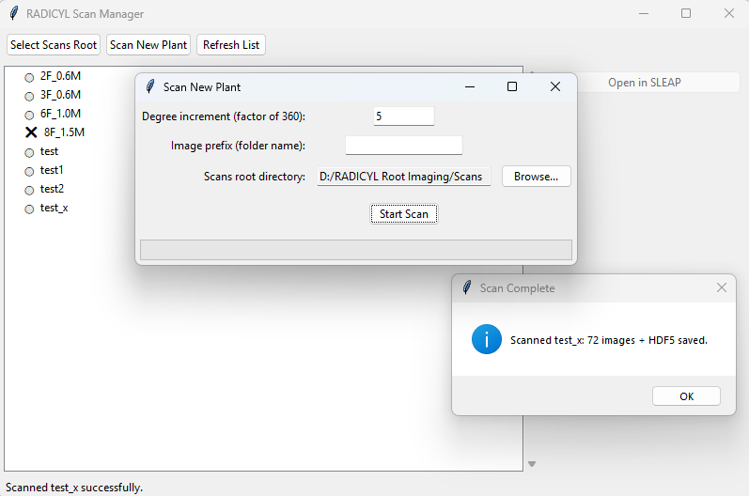
Step 6: Scan New Plant
Wait for the sample to be scanned

Slide 9
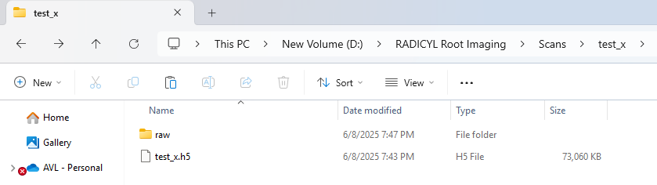
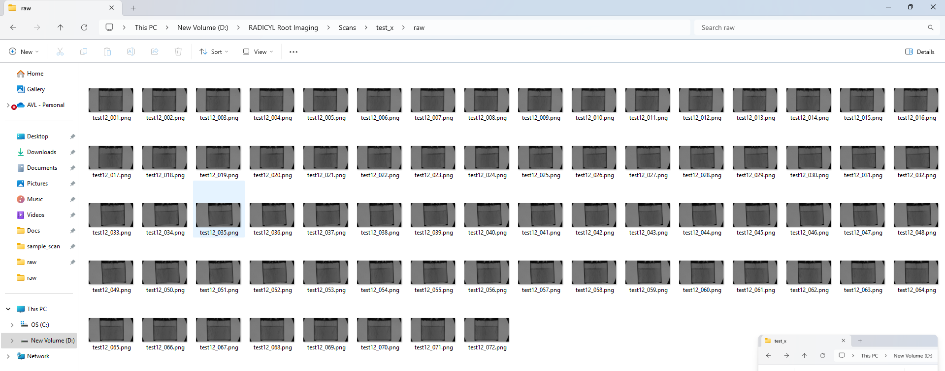
Step 6: Scan New Plant
The sample will be saved in the Scans folder with the sample name the user chooses In the sample folder the folder raw contains all the images, the file with extension .h5 is also created using the raw images and will be used to annotate using SLEAP AI. The annotated file will be saved in the respective sample folder

Slide 10
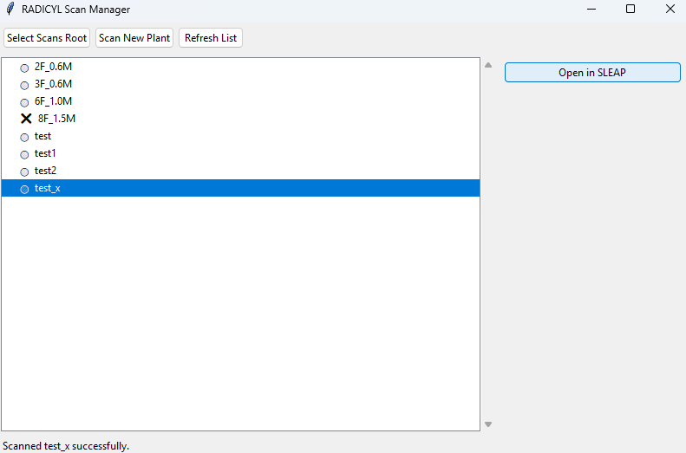
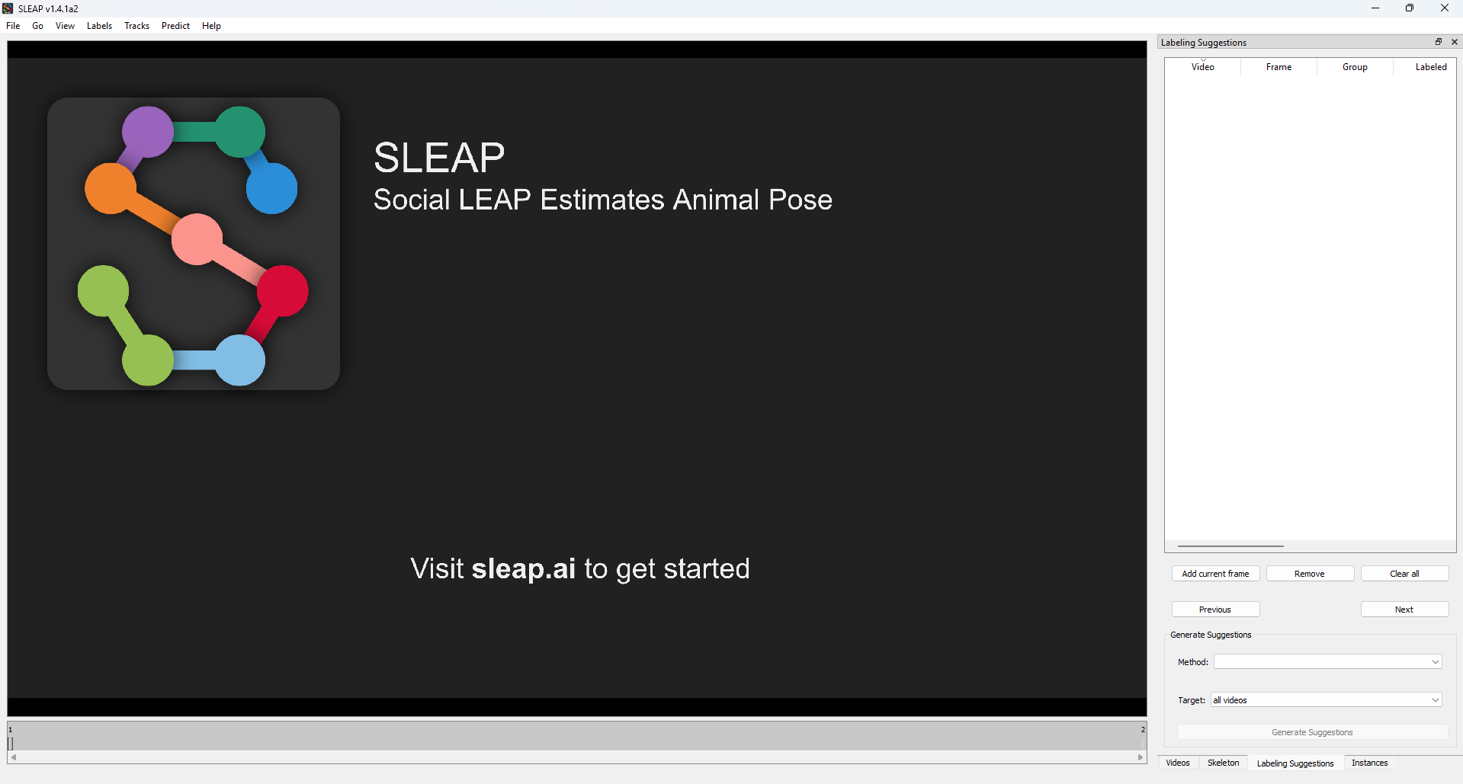
Step 7: Annotate using SLEAP AI
Choose the sample you want to annotate and click Open in SLEAP, which will open the AI tool

Slide 11
Step 8:
To be continued

